Slide 1
Memory Hierarchy

Slide 2
Memory Hierarchy
The memory unit is an essential component in any digital computer since it is needed for storing programs and data
Not all accumulated information is needed by the CPU at the same time
Therefore, it is more economical to use low-cost storage devices to serve as a backup for storing the information that is not currently used by CPU

Slide 3
Memory Hierarchy
Computer Memory Hierarchy is a pyramid structure that is commonly used to illustrate the significant differences among memory types.
The memory unit that directly communicate with CPU is called the main memory
Devices that provide backup storage are called auxiliary memory
The memory hierarchy system consists of all storage devices employed in a computer system from the slow by high-capacity auxiliary memory to a relatively faster main memory, to an even smaller and faster cache memory

Slide 4
MEMORY HIERARCHY
Memory Hierarchy is to obtain the highest possible access speed while
minimizing the total cost of the memory system
Auxiliary memory
Magnetic
tapes
I/O
Main
processor
memory
Magnetic
disks
CPU
Cache
memory
Register
Cache
Main Memory
Magnetic Disk
Magnetic Tape

Slide 5
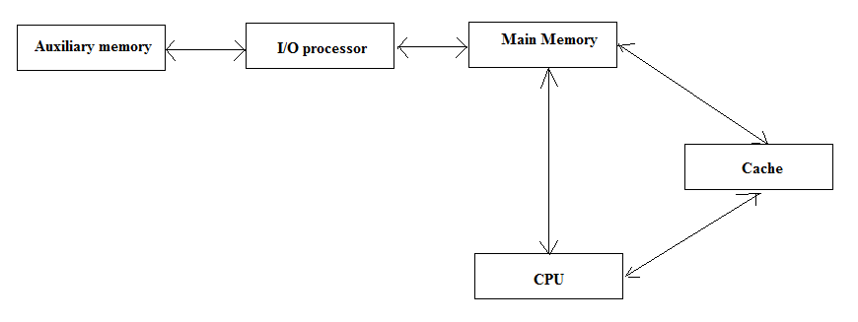
Memory Hierarchy
The main memory occupies a central position by being able to communicate directly with the CPU and with auxiliary memory devices through an I/O processor
A special very-high-speed memory called cache is used to increase the speed of processing by making current programs and data available to the CPU at a rapid rate

Slide 6
Memory Hierarchy
CPU logic is usually faster than main memory access time, with the result that processing speed is limited primarily by the speed of main memory
The cache is used for storing segments of programs currently being executed in the CPU and temporary data frequently needed in the present calculations
The typical access time ratio between cache and main memory is about 1to7
Auxiliary memory access time is usually 1000 times that of main memory

Slide 7
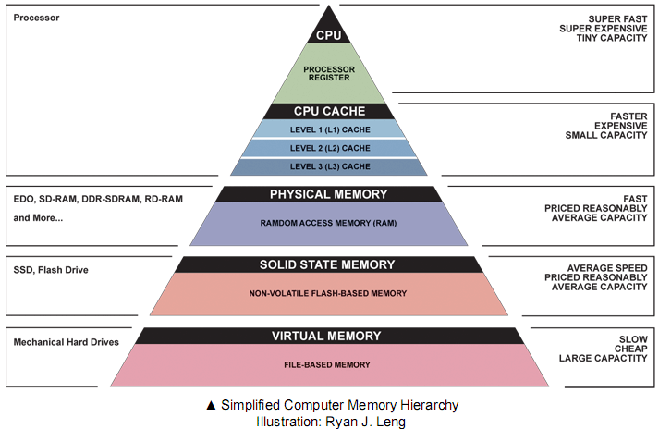

Slide 8
Main Memory
Most of the main memory in a general purpose computer is made up of RAM integrated circuits chips, but a portion of the memory may be constructed with ROM chips
RAM– Random Access memory
  Integated RAM are available in two possible operating modes, Static and Dynamic
ROM– Read Only memory

Slide 9
Main Memory
A RAM chip is better suited for communication with the CPU if it has one or more control inputs that select the chip when needed
The Block diagram of a RAM chip is shown next slide, the capacity of the memory is 128 words of 8 bits (one byte) per word

Slide 10
Memory Block Diagram
A basic memory system is shown here:
k address lines are decoded to address 2^{k} words of memory.
Each word is n bits.
Read and Write are single control lines defining the simplest of memory operations.
n Data Input Lines
n
k Address Lines
Memory
k
Unit
2^{k} Words
1
n Bits per Word
Read
1
Write
n
n Data Output Lines

Slide 11
Memory units
The capacity of a memory unit is usually stated as the total numbers of bytes that can store.
Term | Normal Usage | Usage of Power
K (Kilo) | 10³ | 2¹⁰ = 1,024
M (Mega) | 10⁶ | 2²⁰ = 1,048,576
G (Giga) | 10⁹ | 2³⁰ = 1,073,741,824
T (Tera) | 10¹¹ | 2⁴⁰ = 1,099,511,627,776

Slide 12
Key Characteristics of Memory
Performance
  Access time
  Cycle time
  Transfer rate
Physical type
  Semiconductor
  Magnetic surface
  Optical
vii. Physical characteristics
  Volatile/non volatile
  Erasable/non erasable
Location
  CPU
  Internal (main)
  External (secondary)
Capacity
  Word size
  Number of words
Unit of Transfer
  Word
  Block
Access methods
  Sequential access
  Direct access
  Random access
  Associative access

Slide 13
Key Characteristics of Memory
Location
  CPU -> in the form of CPU registers, which are used by CPU as its local memory
  Internal (main)- main memory
  External (secondary) -> consists of peripheral device, such as disk and tape that are accessible to CPU via I/O controllers

Slide 14
Capacity
Capacity
  Word size- number of bytes
  Number of words-also depends on the number of words in memory.
  Total capacity of internal memory can be calculated as follows:
    Total memory= Number of words in memory * word length
    Number of words=2^{address bus width}

Slide 15
Key Characteristics of Memory (cont..)
Unit of transfer
  Word
    For the internal memory, the unit of transfer is equal to the number of data lines into and out of the main memory module. This is equal to the one word length, but it may not be. The common word lengths are 8,16,and 32 bits.
  Block
    For external memory, the data often transferred in much longer units than a word, and these are referred to as Blocks.

Slide 16
Access methods
The method of accessing data can be categorized into four types :
  Sequential Access
    Memory is organized into units of data, called Records.
    Access must be made in a specific linear sequence .
    Stored addressing information is used to separate records and assist in the retrieval process shared read/ write mechanism is used , and this must be moved its current location to the desired location , passing and rejecting each intermediate record .
    Thus the time to access an arbitrary record is highly variable.

Slide 17
Access methods
  Direct Access
    As with sequential access, direct access involved a shared read write mechanism.
    However, individual blocks or records have a unique address based on physical location.
    Access is accomplished by general access to reach a general vicinity plus sequential searching, counting, waiting to reach the final location.
    Again access time is variable.

Slide 18
Access methods
  Random Access
    Each addressable location in the memory has unique, physically wired- in addressing mechanism.
    The time to access a given location is independent of the sequences of prior access and is constant.
    Thus any location can be selected at random and directly addressed and accessed .
    The main memory systems are a random access.

Slide 19
Access methods
  Associative access
    This is Random access type that enables one to make a comparison of desired bit locations within a word for specific match and to do this for all words simultaneously .
    Thus a word is retrieved based on a portion of its contents rather than its address .
    As with ordinary random access memory each location has its own addressing mechanism and retrieval time is constant independent of location or prior access patterns.

Slide 20
Performance
Access Time:
    The time required to read/write the data from /into desired record is called Access time.
    The access time is depends on amount of data to be read/write in the desired record .
    If the amount data is uniform for all records then the access time is same for all records.
Cycle Time:
    Is the combination access time plus time required to locate desired record.
    For Random access method ,this memory cycle time is same for all records ,because the time to access a given record is independent of the location. where as for the sequential access and direct access ,the memory cycle time is different because the time to locate a given record is depend of the position of desired record with respect to first record and access time same for all records.

Slide 21
Performance
Transfer rate:
    The rate at which the data can be transferred into or out of a memory unit.
  For random access memory it is equal to 1/cycle time
  For non random access memory the following relationship holds:
    Tn =Ta +(N/R )
      Where
      Tn = Average time to read or write N bits
      Ta =Average access time
      N = Number of bits
      R = Transfer rate ,in bits per second (BPS)

Slide 22
Key Characteristics of Memory (cont..)
Physical Type: so popular memory
  Semiconductor
  Magnetic Surface
  Optical
Physical Characteristics
  Volatile/non volatile-
    information decays when electrical power is lost.
  Erasable/non erasable-
    the information once record remains without deterioration until deliberately changed.
    No electrical power is needed to retain the information.

Slide 23
Types of Main Memories
Read Only Memory (ROM)
Random Access Memory (RAM)

Slide 24
RAM
Read/write memory, that initially doesn’t contain any data
The computing system that it is used in usually stores data at various locations to retrieve it latter from these locations
Its data pins are bidirectional (data can flow into or out of the chip via these pins), as opposite to those of ROM that are output only
It loses its data once the power is removed, so it is a volatile memory
It has a directional select signal R/W’; When R/W’=1, the chip outputs data to the rest of the circuit; when R/W’ = 0 it inputs data from the rest of the circuit

Slide 25
Random-Access Memory
Key features
  RAM is packaged as a chip.
  Basic storage unit is a cell (one bit per cell).
  Multiple RAM chips form a memory.
Static RAM (SRAM)
  Each cell stores bit with a six-transistor circuit.
  Retains value indefinitely, as long as it is kept powered.
  Relatively insensitive to disturbances such as electrical noise.
  Faster and more expensive than DRAM.
Dynamic RAM (DRAM)
  Each cell stores bit with a capacitor and transistor.
  Value must be refreshed every 10-100 ms.
  Sensitive to disturbances.
  Slower and cheaper than SRAM.

Slide 26
SRAM DRAM
Volatile - volatile
Faster - slower
smaller memory units - larger memory units
Complex construction - simpler to build
Don’t require - require refresh
refreshing circuit
Cache memory - Main memory
Larger per bit - smaller per bit
Digital - analog

Slide 27
ROM
ROM is used for storing programs that are PERMENTLY resident in the computer and for tables of constants that do not change in value once the production of the computer is completed
The ROM portion of main memory is needed for storing an initial program called bootstrap loader, witch is to start the computer software operating when power is turned off

Slide 28
ROM
Data is programmed into the chip using an external ROM programmer
The programmed chip is used as a component into the circuit
The circuit doesn’t change the content of the ROM
Can be used as lookup tables to implement various functions
Used by PCs to store the instructions that form their Basic Input/Output System (BIOS)
When power is removed from a ROM chip, the information is not lost, so it is a nonvolatile type of memory
It has a OE (Output Enable) specific control pin. Both OE and CE must be enabled in order for the ROM to output data; otherwise its data output is tri-stated.

Slide 29
ROM Types
Masked ROM – programmed with its data when the chip is fabricated
PROM – programmable ROM, by the user using a standard PROM programmer, by burning some special type of fuses. Once programmed will not be possible to program it again
EPROM – erasable ROM; the chip can be erased and chip reprogrammed; programming process consists in charging some internal capacitors; the UV light (method of erase) makes those capacitors to leak their charge, thus resetting the chip
EEPROM – Electrically Erasable PROM; it is possible to modify individual locations of the memory, leaving others unchanged; one common use of the EEPROM is in BIOS of personal computers.

Slide 30
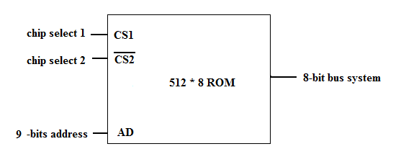
ROM

Slide 31
Nonvolatile Memories
DRAM and SRAM are volatile memories
  Lose information if powered off.
Nonvolatile memories retain value even if powered off.
  Generic name is read-only memory (ROM).
  Misleading because some ROMs can be read and modified.
Types of ROMs
  Programmable ROM (PROM)
  Eraseable programmable ROM (EPROM)
  Electrically eraseable PROM (EEPROM)
  Flash memory
Firmware
  Program stored in a ROM
    Boot time code, BIOS (basic input/ouput system)
    graphics cards, disk controllers.

Slide 32
Cache memory
If the active portions of the program and data are placed in a fast small memory, the average memory access time can be reduced,
Thus reducing the total execution time of the program
Such a fast small memory is referred to as cache memory
The cache is the fastest component in the memory hierarchy and approaches the speed of CPU component

Slide 33
Cache memory
When CPU needs to access memory, the cache is examined
If the word is found in the cache, it is read from the fast memory
If the word addressed by the CPU is not found in the cache, the main memory is accessed to read the word

Slide 34
Cache memory
The performance of cache memory is frequently measured in terms of a quantity called hit ratio
When the CPU refers to memory and finds the word in cache, it is said to produce a hit
Otherwise, it is a miss
Hit ratio = hit / (hit+miss)

Slide 35
Cache memory
The basic characteristic of cache memory is its fast access time,
Therefore, very little or no time must be wasted when searching the words in the cache
The transformation of data from main memory to cache memory is referred to as a mapping process, there are three types of mapping:
  Associative mapping
  Direct mapping
  Set-associative mapping

Slide 36
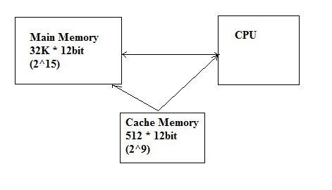
Cache memory
To help understand the mapping procedure, we have the following example:

Slide 37
Memory Address Map
Memory Address Map is a pictorial representation of assigned address space for each chip in the system
To demonstrate an example, assume that a computer system needs 512 bytes of RAM and 512 bytes of ROM
The RAM have 128 byte and need seven address lines, where the ROM have 512 bytes and need 9 address lines

Slide 38
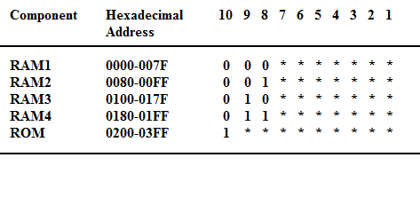
Memory Address Map

Slide 39
Memory Address Map
The hexadecimal address assigns a range of hexadecimal equivalent address for each chip
Line 8 and 9 represent four distinct binary combination to specify which RAM we chose
When line 10 is 0, CPU selects a RAM. And when it’s 1, it selects the ROM

Slide 40
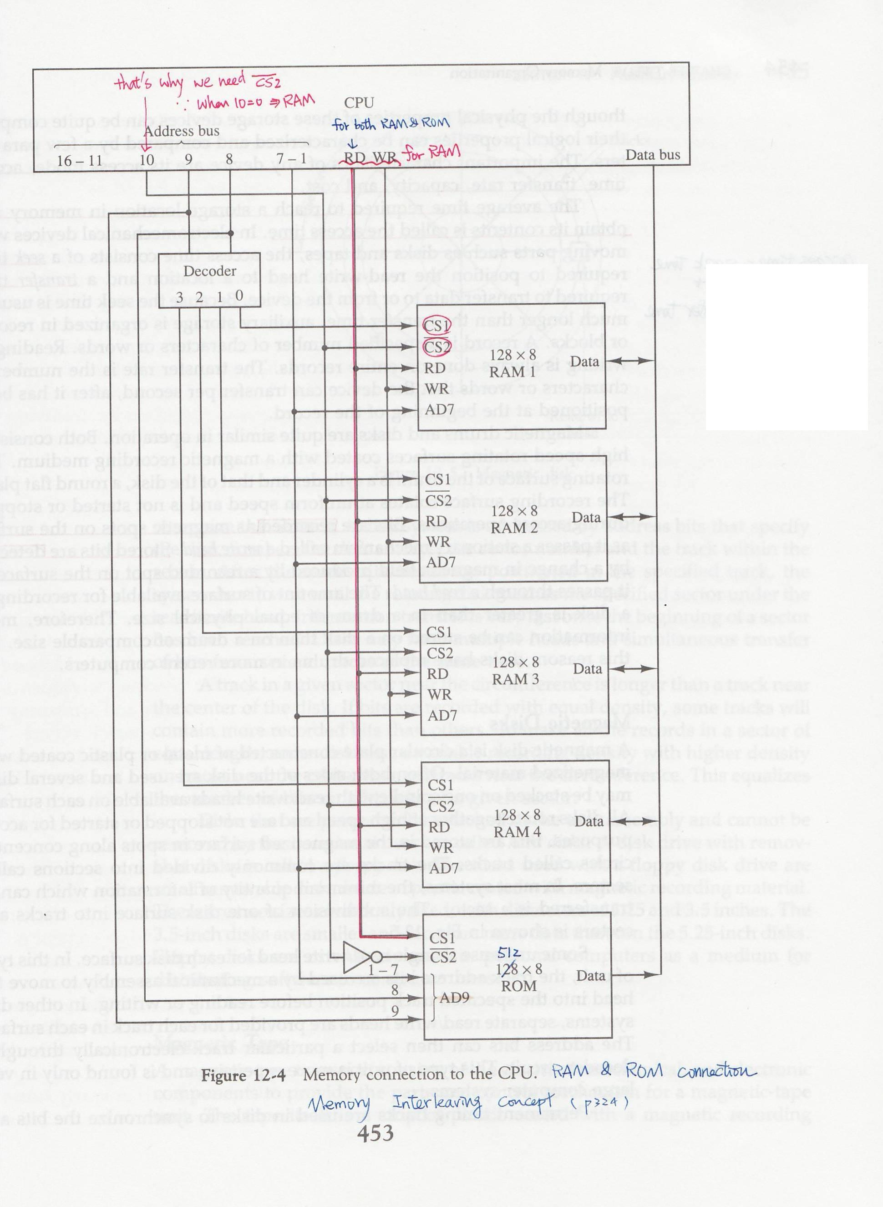

Slide 41
Associative mapping
The fastest and most flexible cache organization uses an associative memory
The associative memory stores both the address and data of the memory word
This permits any location in cache to store an word from main memory
The address value of 15 bits is shown as a five-digit octal number and its corresponding 12-bit word is shown as a four-digit octal number

Slide 42
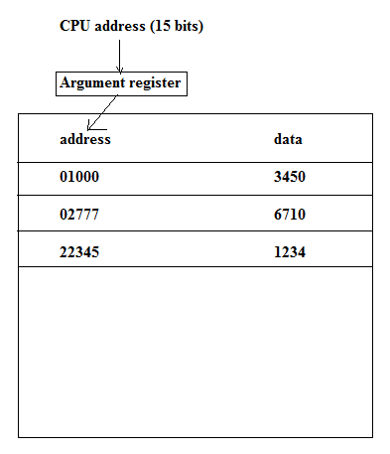
Associative mapping

Slide 43
Associative mapping
A CPU address of 15 bits is places in the argument register and the associative memory searched for a matching address
If the address is found, the corresponding 12-bits data is read and sent to the CPU
If not, the main memory is accessed for the word
If the cache is full, an address-data pair must be displaced to make room for a pair that is needed and not presently in the cache

Slide 44
Direct Mapping
Associative memory is expensive compared to RAM
In general case, there are 2^k words in cache memory and 2^n words in main memory (in our case, k=9, n=15)
The n bit memory address is divided into two fields: k-bits for the index and n-k bits for the tag field

Slide 45
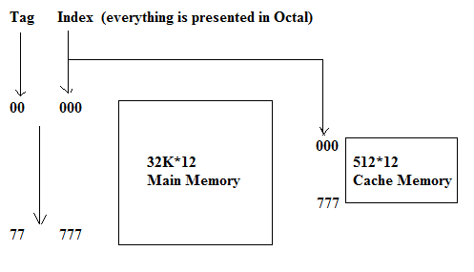
Direct Mapping

Slide 46
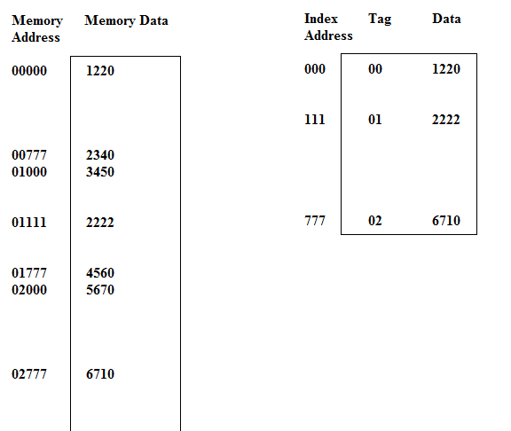
Direct Mapping

Slide 47
Set-Associative Mapping
The disadvantage of direct mapping is that two words with the same index in their address but with different tag values cannot reside in cache memory at the same time
Set-Associative Mapping is an improvement over the direct-mapping in that each word of cache can store two or more word of memory under the same index address

Slide 48
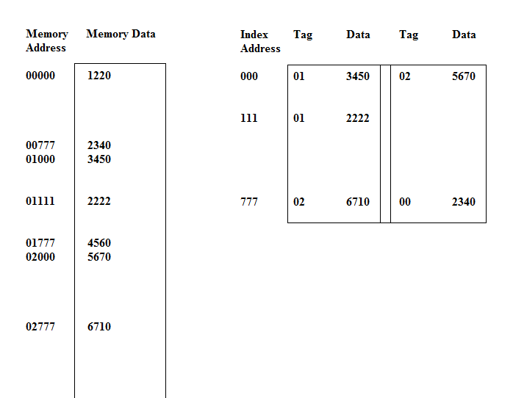
Set-Associative Mapping

Slide 49
Set-Associative Mapping
In the slide, each index address refers to two data words and their associated tags
Each tag requires six bits and each data word has 12 bits, so the word length is 2*(6+12) = 36 bits

Slide 50
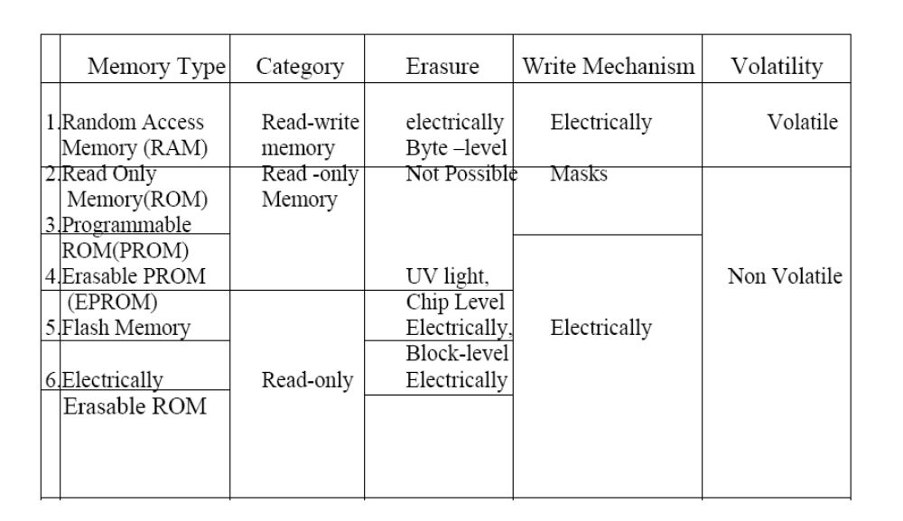
Comparison of memories

